Slide 1
Progress 2016-03-23
Muhammad Arif Nasution
1306500580

Slide 2
Convolution Neural Network

Slide 3
CNN
Menggunakan 3 dimensi
Width
Height
Depth (dimension of an activation volume)

Slide 4
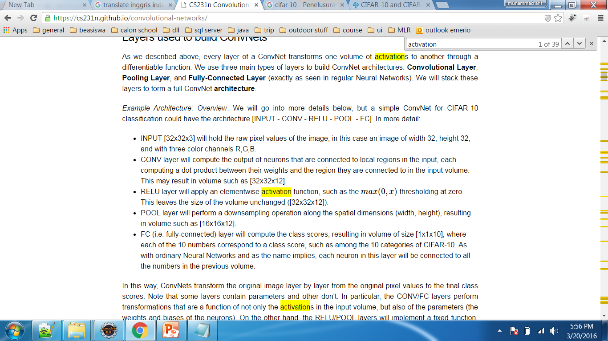
Arsitektur

Slide 5
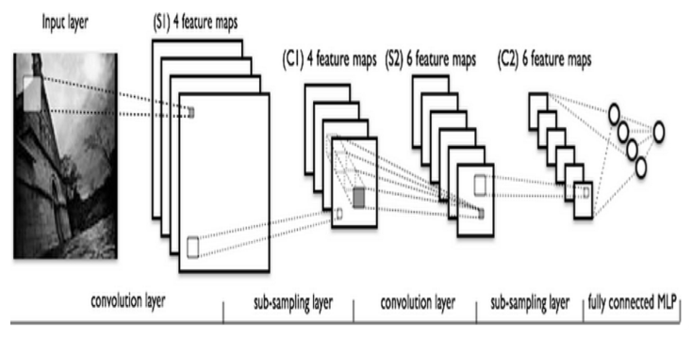
Arsitektur

Slide 6
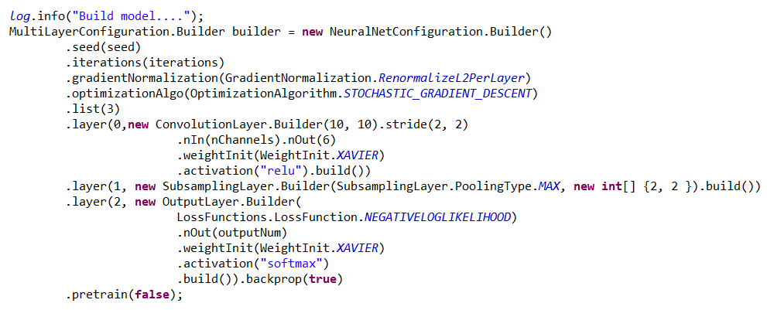
Source Code

Slide 7
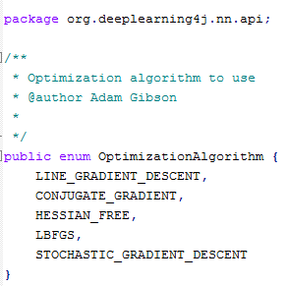
Source Code

Slide 8
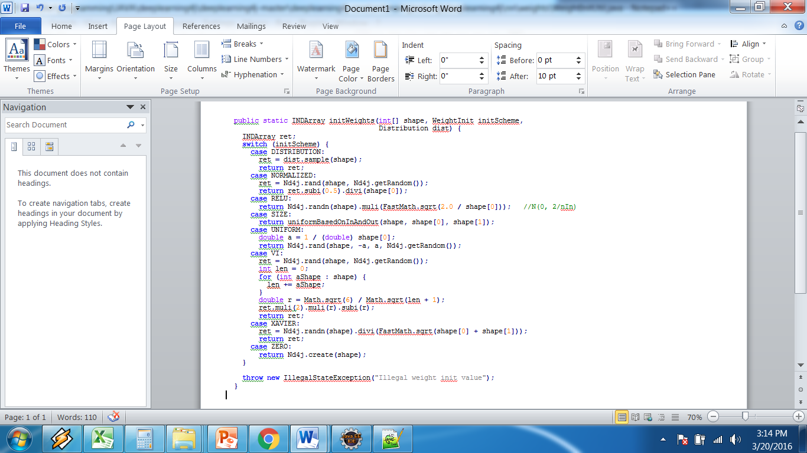
org.deeplearning4j.nn.weights. WeightInitUtil

Slide 9
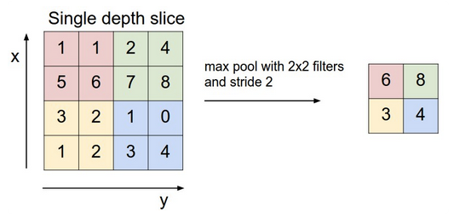
Sample Pooling

Slide 10
Representasi

